Slide 1
UNIT III
Supervised Learning
Classification

Slide 2
Example of Supervised Learning

Slide 3
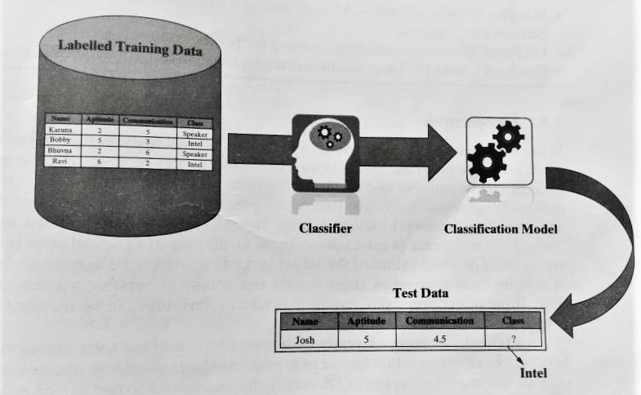
CLASSIFICATION MODEL
TYPICAL PROBLEMS – Image Classification, Disease prediction, win-loss prediction of games, prediction of natural calamity, handwriting classification

Slide 4

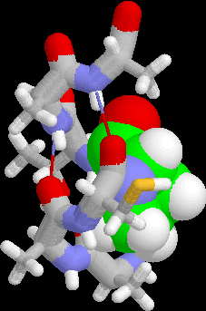
Examples of Classification Task
Predicting tumor cells as benign or malignant
Classifying credit card transactions as legitimate or fraudulent
Classifying secondary structures of protein as alpha-helix, beta-sheet, or random coil
Categorizing news stories as finance, weather, entertainment, sports, etc.

Slide 5
Classification Learning Steps
Problem
Identification of required Data
Data Preprocessing
Definition of Training Set
Algorithm Selection
Parameter Training
Training
Evaluation with test set
OK
Classifier

Slide 6
COMMON CLASSIFICATION ALGORITHMS
k – Nearest Neighbor (kNN)
Decision Tree
Random Forest
Support Vector Machine (SVM)
Naïve Bayes Classifier

Slide 7
1. k – Nearest Neighbor (kNN)
Simple but extremely powerful classification algorithm
Class label of the unknown element is assigned on the basis of class labels of the similar training data set elements
Distance based

Slide 8
kNN Algorithm
Input : Training data set, test data set (or data points), values of ‘k’ ( no of nearest neighbors to be considered)
Steps:
Do for all test data points
calculate the distance (usually Euclidean distance) of the test data point from the different training data points
Find the closest ‘k’ training data points – whose distance are least from the test data point
If K = 1
then
assign class label of the training data point to the test data point
Else
whichever class label is predominantly present in the training data points, assign that class label to the test data point
End Do

Slide 9
Example

Slide 10
Strengths of kNN algorithm
Extremely simple algorithm – easy to understand
Very effective in certain situations – eg, recommender system design
Very fast and almost no time required for the training phase
Weakness of the kNN algorithm
Doesn’t learn anything in real sense – classification done on basis of training data, heavy reliance on the training data
The classification process is slow
Large amount of computational space is required to load the training data for classification
Application of the kNN algorithm
Recommender system – liking pattern based on past purchases or browsing history
Searching documents / contents similar to given document/content – information retrieval – concept search

Slide 11
Why kNN algorithm is called a lazy learner
Eager learners follow the general steps of ML, i.e, perform abstraction of the data, then follow the generalization step - kNN these steps are skipped
kNN stores the training data and directly applies the philosophy of nearest neighborhood finding to arrive at the classification
kNN no learning happening in real sense – hence lazy learner
Strengths of kNN algorithm
Weakness of the kNN algorithm
Application of the kNN algorithm

Slide 12
2. Decision Trees
Decision trees are powerful and popular tools for classification and prediction.
Decision trees represent rules, which can be understood by humans and used in knowledge system such as database.
A tree with three types of nodes:
Root Node
Branch Nodes
Leaf Nodes
Internal nodes – Root / Branch Specifies a choice or test of some attribute with 2 or more alternatives; part of a path to a leaf node
Leaf node: Indicates classification of an example

Slide 13
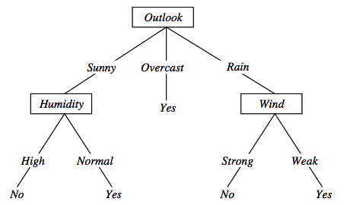
Decision tree representation (PlayTennis)
⟨Outlook=Sunny, Temp=Hot, Humidity=High, Wind=Strong⟩ No
Notes:
Each node represents a test on an attribute of the instance to be classified and each outgoing arch a possible outcome, leading to a further test.
The leafs correspond to classification actions. A binary classification in this case.
The instance <Outlook=Sunny, Temp=Hot, Humidity=High, Wind=Strong> is classified as No.

Slide 14
When to use Decision Trees
Data set in which there is a finite list of attributes
Each attribute has a small number of distinct values
No infinite loops on taking a decision
Possibly noisy training data samples
Robust to errors in training data
Missing attribute values
Different classification problems:
Equipment or medical diagnosis
Credit risk analysis
Several tasks in natural language processing

Slide 15
Building a Decision Tree
DTs are built corresponding to the training data following – recursive partitioning
Splits the data into multiple subsets on the basis of the feature values
Starts from the root node, which is nothing but the entire data set
Selects the feature which predicts the target class in the strongest way
The DT splits the data into multiple partitions, with data in each partition having a distinct value for the feature based on which the partitioning has done

Slide 16
Cont..
The algorithm continues splitting the nodes on the basis of the feature which helps in the best partition
Continue till stopping criterion is reached – usual criteria to stop splitting –
All or most of the examples of a particular node have the same class
All features have been used up in the partitioning
The tree has grown to a pre-defined threshold limit

Slide 17
Implementations of Decision Trees
C5.0
CART ( Classification and Regression Tree)
CHAID (Chi – Square Automatic Interaction Detector)
ID3 (Interactive Dichotomiser 3) is a basic algorithm for learning DT's
The construction of the tree is top-down. The algorithm is greedy.
The fundamental question is “which attribute should be tested next? Which question gives us more information?”
Select the best attribute
A descendent node is then created for each possible value of this attribute and examples are partitioned according to this value
The process is repeated for each successor node until all the examples are classified correctly or there are no attributes left

Slide 18
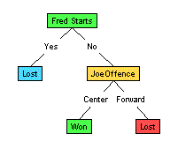
Illustration
(1) Which to start? (root)
(2) Which node to proceed?
(3) When to stop/ come to conclusion?

Slide 19
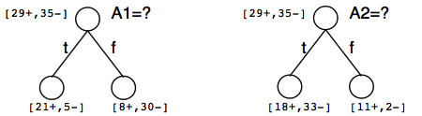
Which attribute is the best classifier?
A statistical property called information gain, measures how well a given attribute separates the training examples
Information gain uses the notion of entropy, commonly used in information theory
Information gain = expected reduction of entropy

Slide 20
Entropy in binary classification
Entropy measures the impurity of a collection of examples. It depends from the distribution of the random variable p.
S is a collection of training examples
c
Entropy(S) = Σ - p_{i}log₂ p_{i}
_{i=1}
Notes:
S=[9+, 5-] una collezione di esempi di cui 9 positivi e 5 negativi

Slide 21
Information gain as entropy reduction
Information gain is the expected reduction in entropy caused by partitioning the examples on an attribute.
The higher the information gain the more effective the attribute in classifying training data.
Expected reduction in entropy knowing A
Gain(S, A) = Entropy(S) − Σ Entropy(Sv)
v ∈ Values(A)
Values(A) possible values for A
Sv subset of S for which A has value v
|Sv|
|S|
Notes:
La riduzione in entropia attesa partizionando sui valori dell’ attributo A

Slide 22
Example
Notes:
Target attrbute = playtennis

Slide 23
Entropy and Information Gain calculation
Iteration I

Slide 26
Inductive bias in decision tree learning
What is the inductive bias of DT learning?
Shorter trees are preferred over longer trees
Not enough. This is the bias exhibited by a simple breadth first algorithm generating all DT's e selecting the shorter one
Prefer trees that place high information gain attributes close to the root
Note: DT's are not limited in representing all possible functions

Slide 27
Issues in decision trees learning
Over fitting
Building trees that “adapt too much” to the training examples may lead to “overfitting”
Two approaches to avoid overfitting
Pre pruning : stop growing the tree before it reaches perfection
Post- pruning : Allow the tree to grow entirely and then post-prune some of the branches from it
Notes:
L'overfitting può succedere quando c' è rumore nei dati.

Slide 28
Weakness of DT
Models are often biased towards features having more number of possible values –i.e, levels
Gets over fitted or under fitted easily
Are prone to errors in classification problems with many classes and relatively small number of training examples
Can be computationally expensive to train
Large trees are complex to understand

Slide 29
Strengths of DT
Simple rules for understanding
Works well for most problems
Can handle both numerical and categorical data
Can work well both with small and large training data sets
Provide a definite clue of which features are more useful for classification

Slide 30
3. Random Forest Model
Ensemble Classifier - that is a combining classifier that uses and combines many decision tree classifiers
Ensembling is usually done using the concept of bagging with different feature sets
Reason – to train the trees - contribution from each feature comes in number of models
Ensemble mode – better than that from individual DTs

Slide 31
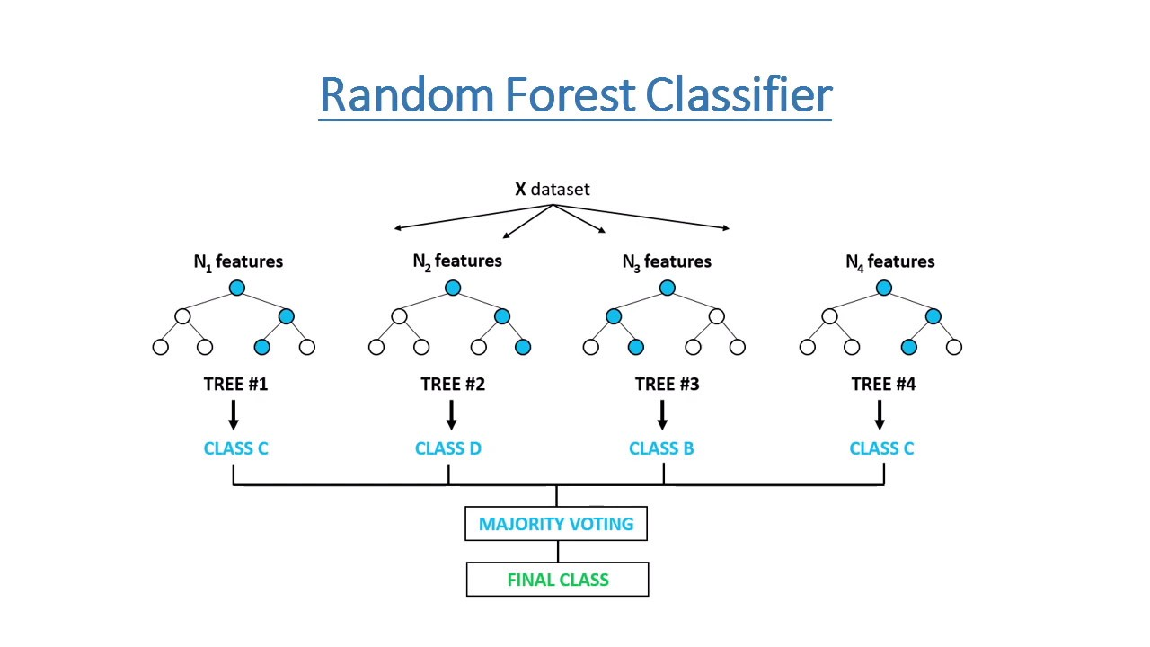

Slide 32
How does random forest work?
If there are N variables or features in the input dataset, select a subset of ‘m’ (m<N) features at random out of N features. Also the observations or data instances should be picked randomly
Use the best split principle on these ‘m’ features to calculate the number of nodes ‘d’
Keep splitting the nodes to child nodes till the tree is grown to the maximum possible extent
Select a different subset of the training data ‘ with replacement’ to train another DT following steps 1-3. repeat this to build and train ‘n’ DTs
Final class assignment is done on the basis of majority votes from the ‘n’ trees

Slide 33
Strengths of random forest
Runs efficiently on large and expansive data sets
Has a robust method for estimating missing data and maintains precision when a large proportion of the data is absent
Powerful technique for balancing errors in a class population of unbalanced data sets
It gives estimates about which features are most important ones in the overall classification
Generates an internal unbiased estimate of the generalization error
Generalized forests can be saved for future use on other data
Can be used to solve both classification and regression problems

Slide 34
Weakness of random forest
Not easy to understand as a decision tree model as it combines a number of DT models
Computationally much more expensive than a simple DT
Application of random forest
Very powerful classifier – combines the versatility of many DT models into a single model
Can solve a wide range of classification problems

Slide 35
4. Support Vector Machine Algorithm
Discriminative classifier formally defined by a separating hyperplane
the algorithm outputs an optimal hyperplane which categorizes new examples
In two dimensional space this hyperplane is a line dividing a plane in two parts where in each class lay in either side

Slide 36
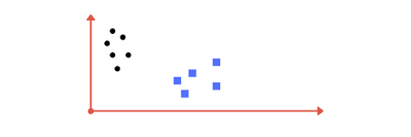
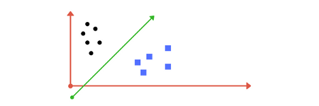

Slide 37
Support Vectors : the data points, the critical component in a data set, which are near the identified set of lines (hyperplane). If SV are removed, they will alter the position of the dividing hyperplane
SVM – feature to ignore outliers and find the hyperplane that has maximum margin – robust to outliers
Challenge with SVM model is to find the optimal hyperplane
Hyperplane should segregate the data instances belonging to two classes in the best possible way
Show maximize the distances between the nearest data points of both the classes, i.e maximize the margin
If need to prioritize between higher margin and lesser misclassification, the hyperplane should try to reduce misclassification

Slide 38
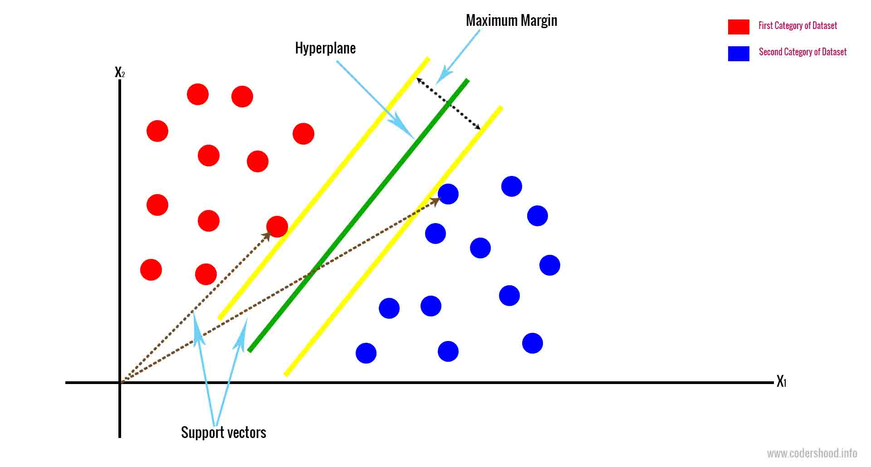
MMH for linearly separable data
Maximum Margin Hyperplane

Slide 39
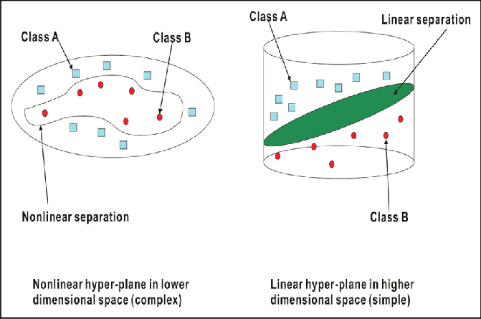
MMH for nonlinear separable data

Slide 40
Strengths of SVM
SVM can be used for both classification and regression
It is robust, i.e. not much impacted by data with noise or outliers
The prediction results using this model are very promising
Application of SVM
Most effective when it is used for binary classification, i.e, for solving a ML problem with 2 classes
Field of bioinformatics – detecting cancer and other genetic disorders
Detecting the image of a face by binary classification of images into face and non face components

Slide 41
Weakness of SVM
SVM is applicable only for binary classification,.i.e, where there are only two classes in the problem domain
SVM model is very complex – like a black box when it deals with high-dimensional data sets – difficult and close to impossible to understand the model in such cases
Slow for a large datasets i.e, a data set with either a large number of features or a large number of instances
It is quite memory intensive

Slide 42
PART B

